Slide 1

Go-Session-5
---------------------
GO Data Types
By Shadab Akhtar

Slide 2
--------------------------------------------------------------------------------------------------
Module Introduction
--------------------------------------------------------------------------------------------------
In this module, we will cover
Introduction to Data Types
Data Types Range
Need for Data Types
Numeric types
String types
Boolean types

Slide 3
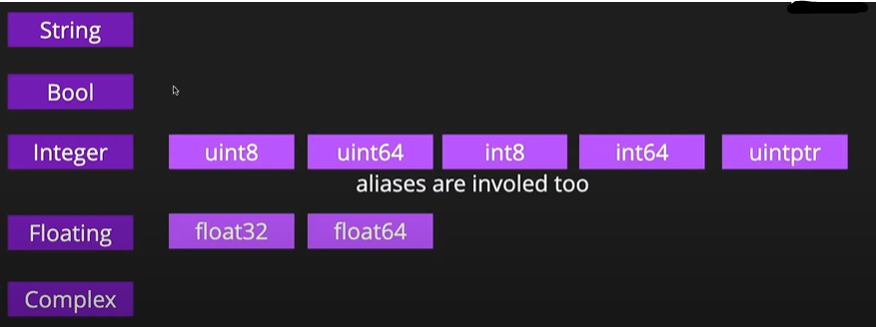
--------------------------------------------------------------------------------------------------
Data Types
--------------------------------------------------------------------------------------------------

Slide 4
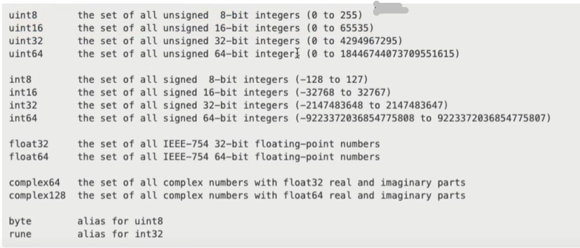
--------------------------------------------------------------------------------------------------
Data Types Range
--------------------------------------------------------------------------------------------------

Slide 5
------------------------------------------------------------------------------------------------Introduction to Data Types
------------------------------------------------------------------------------------------------
In Go programming, data types are a fundamental concept that defines the type of data a variable can hold. Go is a statically typed language, which means that you must declare the data type of a variable when you create it. This helps the compiler catch type-related errors at compile time, making Go a safe and efficient language.
Here are some of the basic data types in Go:
---------------------------------------
1. Numeric Types:
- int: Represents signed integers. The size of `int` depends on the platform, but it's usually either 32 or 64 bits.
- uint: Represents unsigned integers. Like `int`, the size depends on the platform.
- int8, int16, int32, int64: Signed integers of specific sizes (8, 16, 32, 64 bits).
- uint8, uint16, uint32, uint64: Unsigned integers of specific sizes.
- float32, float64: Represents floating-point numbers with single and double precision, respectively.
- complex64, complex128: Represents complex numbers with 32-bit and 64-bit parts.
2. Boolean Type:
- bool: Represents boolean values, which can be either `true` or `false`.
3. String Type:
- string: Represents a sequence of characters, such as "hello, world".

Slide 6
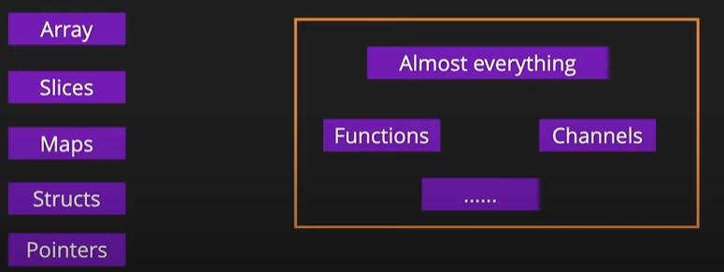
--------------------------------------------------------------------------------------------------
Data Types
--------------------------------------------------------------------------------------------------

Slide 7
------------------------------------------------------------------------------------------------
Introduction to Data Types
------------------------------------------------------------------------------------------------
4.Character Type:
In Go, there is no distinct character type like in some other languages. Instead, you can use byte or rune to represent individual characters.
byte: Represents a single byte (an alias for uint8) and is often used for ASCII characters.
rune: Represents a Unicode character and is used for handling Unicode text
5. Composite Types:
- Array: A fixed-size collection of elements of the same data type.
- Slice: A dynamic and flexible version of an array. Slices are often used when you need a collection with a variable length.
- Map: A collection of key-value pairs. Maps are similar to dictionaries in other languages.
- Struct: A user-defined composite data type that groups together variables under a single type.
6. Pointer Types:
- Pointer: Represents the memory address of a variable's value.

Slide 8
--------------------------------------------------------------------------------------------------
Introduction to Data Types
--------------------------------------------------------------------------------------------------
7. Function Types:
- Function: Functions can be assigned to variables, passed as arguments, and returned from other functions.
8. Interface Types:
- Interface: Defines a set of method signatures. Types that implement all the methods of an interface implicitly satisfy that interface.
9. Channel Types:
- Channel: Used for communication and synchronization between goroutines in concurrent programming.
These are the fundamental data types in Go. When you declare a variable, you specify its data type explicitly, like this:
var age int
var name string
var isStudent bool
Go's strong typing and explicit type declaration make code more reliable and readable, and it helps catch type-related errors at compile time, making it a robust choice for developing scalable and maintainable software.

Slide 9
--------------------------------------------------------------------------------------------------
Need for Data Types
--------------------------------------------------------------------------------------------------
In the Go programming language, data types play a crucial role in programming by helping developers define the kind of data a variable can hold and perform operations on. They provide several benefits:
1. Type Safety: Go is a statically typed language, which means that variable types are defined at compile time. This provides type safety and helps catch type-related errors at compile time rather than at runtime. This reduces the likelihood of bugs and makes the code more robust.
2. Memory Allocation: Data types determine the amount of memory allocated to a variable. This is important for optimizing memory usage, especially in systems programming and when working with large datasets.
3. Code Clarity: Explicitly specifying data types makes the code more readable and self-explanatory. It communicates the developer's intent and helps others understand the purpose of variables and functions.
4. Performance: Data types can impact the performance of your code. For example, using the correct numeric data type can ensure efficient arithmetic operations. Go provides a range of data types for different use cases, such as int, float64, and complex128, each with its own performance characteristics.

Slide 10
--------------------------------------------------------------------------------------------------
Need for Data Types
--------------------------------------------------------------------------------------------------
5. Interoperability: Go often interacts with external systems, libraries, and APIs. Using the correct data types ensures compatibility and smooth data exchange with these external components.
6. Function Signatures: Data types are essential for defining function signatures. When you define a function, you specify the data types of its parameters and return values. This helps the Go compiler enforce type correctness when calling functions and passing arguments.
7. Type Conversion: Go allows you to convert data between compatible data types explicitly. This can be useful when you need to perform operations involving different types or when you want to ensure data integrity during conversion.
8. Interfaces: Interfaces are a fundamental concept in Go, and data types play a role in defining interface contracts. You can define interfaces that specify the behavior expected from different data types, enabling polymorphism and code reuse.
Overall, data types in Go provide a foundation for writing reliable, efficient, and maintainable code. They enable the language to strike a balance between flexibility and safety, making it well-suited for a wide range of applications.

Slide 11
--------------------------------------------------------------------------------------------------
Module Summary
--------------------------------------------------------------------------------------------------
In this module, we have covered
-------------------------------
Introduction to Data Types
Need for Data Types
Numeric types
String types
Boolean types

Slide 12


Slide 13


